Slide 1
UPT Backwards Compatibility
Vijay Parmar

Slide 2
Agenda
Requirements
Solution
Overall diagram
Overall workflow

Slide 3
Requirements
Business Requirements
  Provide a new UPT installation that allows provisioning users on multiple CSM Schema versions
  Easy to incorporate future versions of UPT

Slide 4
Requirements contd.
Technical Requirements
  Seamless integration of UPT versions 3.1, 3.2, 4.0, 4.1
    The new version of UPT should allow seamless integration of the different versions of existing UPT web applications. The new UPT application should provide the Login screen that is same as existing ones available in existing UPT versions. This allows users to work with familiar screens and ease of use.
  Auto detect UPT version based on the User login
    The Users of UPT application may or may not know the version of CSM Schema or version of the UPT that is being used. It is required to detect version of the CSM Schema based on the Login ID, Password and Application Context provided by the user.
  The solution should be extensible to allow incorporating future versions of UPT with minimal changes to source code.
  Provide an easy to configure and deployment procedure for the new approach
    Easy deployment
    Easy to manage applications using different versions of UPT on same container.

Slide 5
Solution
Login and Forwarding Web application
  Central Authentication for UPT applications installed in one Application Server
  Configurable list of UPT versions for the installation
  Easy extension and enhancement.
Modified UPT applications
  Delegate the authentication logic to the Login and Forwarding web application.
  Upgrade to the current technology stack, CSM and CLM jars.
  Configurable context name of the Login and Forwarding web application
Package all web applications into Enterprise Application (EAR file).

Slide 6

UPTEAR application
JBoss Server
UPTEAR.ear
Login and Forwarding
Web Application
Authenticate User / Check if User has access to Application
CSM 3.1 Schema
UPT 3.1
Web Application
Provision Auth Policy
Pass Control
CSM 3.2 Schema
UPT 3.2
Web Application
Pass Control
Provision Auth Policy
User attempts Login
UPT 4.0
Web Application
CSM 4.0 Schema
Pass Control
Provision Auth Policy
Pass Control
UPT 4.1
Web Application
CSM 4.1 Schema
Provision Auth Policy
Authenticate User / Check if User has access to Application
LDAP
Authenticate User

Slide 7
Overall Workflow
Login and Forwarding Web Application
User authenticated
Check if User has access to Application Context
Populate CSM Login ID and Application Context Name to HTTP Request
Validate User Id and password
Yes
No
User has access
Obtain context of UPT and forward request to UPT web application context
Login Screen for User
No
Yes
UPT Web Application
Redirect to context for Login Web Application
Yes
No
Session is new / Timed out
User ID available in Session
User accesses a UPT page
No
Yes
Allow Access to UPT page

Slide 8
Limitations
The application context names must be unique per installation
  This is necessary for intelligent (auto) forwarding to UPT web applications by the Login web app.

Slide 9
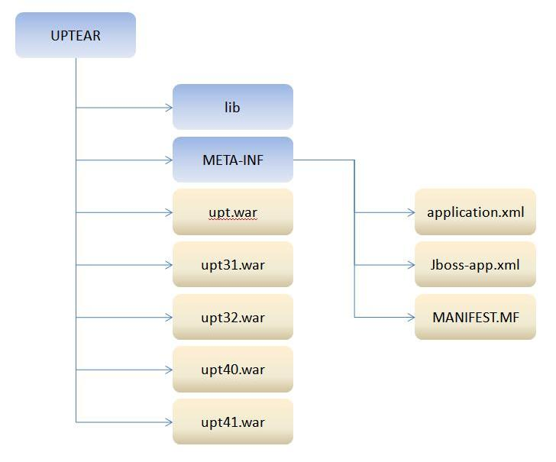
Structure of the UPTEAR

Slide 10
Other Solution evaluated
New “Master” UPT to manage all schemas
  Effort Involved
    Refactor UPT to handle previous and future schemas
  Cons
    High Complexity and not scalable
    Not extensible for future versions CSM schemas.
    Tech Stack issues
    CLM related issues

Slide 11

UPTEAR.ear
Forwarding Sample code
1)
//Get Context of UPT 40 from configuration file
//uptearProperties.getContext(“UPT40”);
RequestDispatcher requestDispatcher ;
requestDispatcher
= request.getRequestDispatcher(
“/upt40" ) ;
requestDispatcher.forward( request, response ) ;
2)
//Get Context of Login web application configuration file
//uptearProperties.getContext(“LOGINFORWARD”);
RequestDispatcher requestDispatcher ;
requestDispatcher
= request.getRequestDispatcher(
“/upt40" ) ;
requestDispatcher.forward( request, response ) ;
Login and Forwarding
Web Application
UPT
Web Application
Pass Control
CSM API
Authenticate
Authorize
Check if User has access
Provision Authorization Policy
Credential Provider
CSM Schema
LDAP
RDBMS

